Slide 1
Ethnographies
Charalambos Themistocleous
www.charalambosthemistocleous.com

Slide 2
Review

Slide 3
Diglossia
Classically defined as a situation where two closely related languages are used in a speech community. One for High (H) functions (e.g., church, newspapers) and one for Low (L) functions (e.g., in the home, or market). The situation is supposed to be relatively stable and the languages/varieties remain distinct (c.f. creole outcomes of language contact).
Now often extended to refer to any two languages even typologically unrelated ones) that have this kind of social and functional distribution.

Slide 4
Bilingualism
Bilingualism/Multilingualism
Individual Bilingualism
Societal Bilingualism
Stable Bilingualism

Slide 5
Code-Switching
In its most specific sense, the alternation between varieties, or codes across sentences or clause boundaries. Often used as cover term including code mixing. Code mixing generally refers to alternations between varieties or codes within a clause or phrase. Often elicits more strongly evaluations than alternations or code switching across clauses.
Situational vs. metaphorical code switching.
Subconsious

Slide 6
Register
Registers are sets of language items associated with discrete occupational or social groups. Surgeons, airline pilots, bank managers, sales clerks, jazz fans, and pimps employ different registers.
As Ferguson (1994, p. 20) says, ‘People participating in recurrent communication situations tend to develop similar vocabularies, similar features of intonation, and characteristic bits of syntax and phonology that they use in these situations.’ This kind of variety is a register.
Ferguson adds that its ‘special terms for recurrent objects and events, and formulaic sequences or “routines,” seem to facilitate speedy communication; other features apparently serve to mark the register, establish feelings of rapport, and serve other purposes similar to the accommodation that influences dialect formation.
There is no mistaking the strong tendency for individuals and co- communicators to develop register variation along many dimensions.’
Of course, one person may control a variety of registers: you can be a stockbroker and an archeologist, or a mountain climber and an economist. Each register helps you to express your identity at a specific time or place, i.e., how you seek to present yourself to others.
(Wardhaugh 2002:50)

Slide 7
Pidgin
Generally, a language variety that is not very linguistically complex or elaborated and is used in fairly restricted social domains and for limited social or interpersonal functions. Like a creole, arises from language contact; often seen as a precursor or early stage to a creole. It is often said that pidgin can be distinguished from a creole in having no native speakers.

Slide 8
Creole
A language variety arising out of a situation of language contact (usually involving more than two languages). A creole can be distinguished from a pidgin: (i) on the grounds that it is the first language of some community or group of speakers, or (ii) on the grounds that it is used for the entire range of social functions that a language can be used for.

Slide 9
Ethnographies

Slide 10
Talkative and non Talkative Communities

Slide 11
Varieties of Talk
It is instructive to look at some of the ways in which various people in the world use talk, or sometimes the absence of talk, i.e., silence, to communicate.

Slide 12
Marshall (1961) has indicated how the !Kung, a bush-dwelling people of South West Africa, have certain customs which help them either to avoid or to reduce friction and hostility within bands and between bands.
The !Kung lead a very harsh life as hunters and gatherers, a life which requires a considerable amount of cooperation and the companionship of a larger group if survival is to be guaranteed. Many of the customs of the !Kung support their social need for cooperativeness and the individual need for personal acceptance.

Slide 13
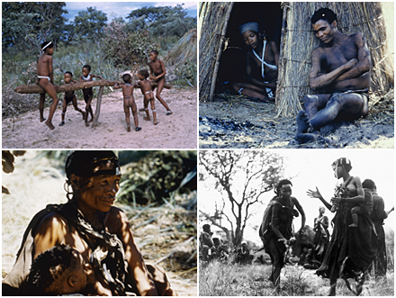
!Kungs

Slide 14
The !Kung are talkative people. Talk keeps communication open among them; it offers an emotional release; and it can also be used to alert individuals that they are stepping out of bounds, so heading off potentially dangerous conflicts between individuals.
The !Kung talk about all kinds of things, but principally about food and gift-giving.

Slide 15
We can contrast the need the !Kung have to talk in order to ensure that tensions do not build up with the Western Apache view of silence (Basso, 1972).
Whereas the !Kung speak to prevent uncertainty in human relationships, the Western Apache of east-central Arizona choose to be silent when there is a strong possibility that such uncertainty exists.

Slide 16
They are silent on ‘meeting strangers,’ whether these are fellow Western Apache or complete outsiders; and strangers, too, are expected to be silent. The Western Apache do not easily enter into new social relationships, and silence is deemed appropriate to a new relationship, because such a relationship is felt to be inherently uncertain.

Slide 17
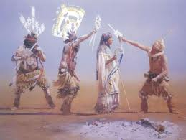
Western Apache

Slide 18
Silence is also used as a kind of sympathizing device after someone dies: you are silent in the presence of ‘people who are sad,’ and you should not further disturb those who are already disturbed by grief.

Slide 19
Silence is also required during curing ceremonials if you are not to be considered disrespectful or to be interfering either with the curing process or with the person conducting the ceremonial.

Slide 20
Silence is often communicative and its appropriate uses must be learned. Among other things it can communicate respect, comfort, support, disagreement, or uncertainty

Slide 21
In many societies people do not talk unless they have something important to say.
As Gardner (1966) has observed, the Puliyanese of south India are neither particularly cooperative nor competitive, and individuals tend to do their own thing.

Slide 22
They do not find much to talk about, and by the time they are 40 or so they hardly seem to talk at all. The Aritama of Colombia are described as being not only taciturn, but also, when they do speak, deliberately evasive.

Slide 23
Several reports have recounted how Danes appreciate silence, being able to sit in one another’s presence for long periods of time without feeling any need to talk and, indeed, finding visitors who insist on talking constantly too demanding. They feel no urge to fill up silences with idle chatter

Slide 24
In other societies, e.g., among certain aboriginal peoples in North America, an acceptable social visit is to arrive at someone’s house, sit around for a while, and then leave with hardly a word spoken all the while.
If you have nothing to say, you do not need to speak, and there is no obligation to make ‘small talk.’

Slide 25
Hymes
S etting, scene
P articipants
E nds
A ct sequence
K ey
I nstrumentalities
N orms of interaction and interpretation
G enre

Slide 26
Ethnographies

Slide 27
Ethnographies are based on first-hand observations of behavior in a group of people in their natural setting. Investigators report on what they see and hear as they observe what is going on around them.

Slide 28
Duranti (1997, p. 85) says,
‘an ethnography is the written description of the social organization, social activities, symbolic and material resources, and interpretive practices characteristic of a particular group of people.’ Ethnographers ask themselves what is happening and they try to provide accounts which show how the behavior that is being observed makes sense within the community that is being observed.

Slide 29
Johnstone (2004, p. 76) says, ethnography ‘presupposes . . . that the best explanations of human behavior are particular and culturally relative’ rather than general and universal. Such studies are also qualitative rather than quantitative.

Slide 30
In ethnographies of speaking the focus is on the language the participants are using and the cultural practices such language reflects. They very often deal with issues of identity and power.

Slide 31
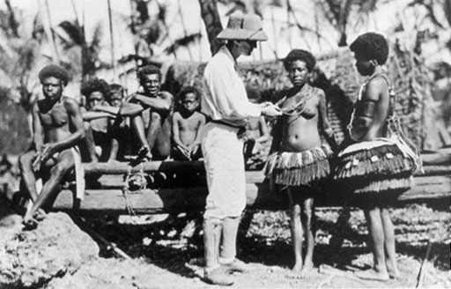
Bronisław Malinowski during his ethnographic research

Slide 32
An alternative approach to devising ethnographies is to attempt to describe the different functions of language in communication.

Slide 33
Function
Halliday’s list covers the following functions:
Instrumental: This is when the child uses language to express their needs (e.g. ‘want juice')
Regulatory: This is where language is used to tell others what to do (e.g. ‘go away')
Interactional: Here language is used to make contact with others and form relationships (e.g. ‘love you, mummy')
Personal: This is the use of language to express feelings, opinions, and individual identity (e.g. ‘me good girl')
Heuristic: This is when language is used to gain knowledge about the environment (e.g. ‘what the tractor doing?')
Imaginative: Here language is used to tell stories and jokes, and to create an imaginary environment.
Representational: The use of language to convey facts and information.

Slide 34
communicative competence
Gumperz (1972, p. 205) explains that term as follows:
‘Whereas linguistic competence covers the speaker’s ability to produce grammatically correct sentences, communicative competence describes his ability to select, from the totality of grammatically correct expressions available to him, forms which appropriately reﬂect the social norms governing behavior in speciﬁc encounters.’

Slide 35
Ethnomethodology
Ethnomethodology's goal is to document the methods and practices through which society’s members make sense of their world.
Is a branch of sociology which is concerned among other things, with talk viewed from a sociological perspective.

Slide 36
Leiter (1980, p. 5) states,
‘the aim of ethnomethodology . . . is to study the processes of sense making (idealizing and formulizing) that members of society . . . use to construct the social world and its factual properties (its sense of being ready-made and independent of perception).’

Slide 37
Ethnomethodologists adopt what is called a phenomenological view of the world; that is, the world is something that people must constantly keep creating and sustaining for themselves.
In this view, language plays a very significant role in that creating and sustaining.
Ethnomethodologists regard ‘meaning’ and ‘meaningful activity’ as something people accomplish when they interact socially.
They focus on what people must do to make sense of the world around them, and not on what scientists do in trying to explain natural phenomena.
Since much of human interaction is actually verbal interaction, they have focused much of their attention on how people use language in their relationships to one another.
They have also focused on how in that use of language people employ what ethnomethodologists call commonsense knowledge and practical reasoning.

Slide 38
Scribner (1977)
All people who own houses pay a house tax.
Boima does not pay a house tax.
Does Boima own a house?

Slide 39
Husband: No, to the shoe repair shop. | No, I stopped at the record store on the way to get him and stopped at the shoe repair shop on the way home when he was with me.
Wife: What for? | I know of one reason why you might have stopped at the shoe repair shop. Why did you in fact?
Husband: I got some new shoe laces for my shoes. | As you will remember, I broke a shoe lace on one of my brown oxfords the other day, so I stopped to get some new laces.
Wife: Your loafers need new heels badly | Something else you could have gotten that I was thinking of. You could have taken in your black loafers which need heels badly. You’d better get them taken care of pretty soon.

Slide 40
Garﬁnkel points out that in such exchanges matters not mentioned or only partially mentioned are still understood, that understanding itself develops as the conversation develops, and that understanding depends on the willingness of each party to work with the other to develop a common scheme of interpretation for what is being talked about.

Slide 41
Case 1
S: Hi, Ray. How is your girl friend feeling?
E: What do you mean, how is she feeling? Do you mean physical or mental?
S: I mean how is she feeling? What’s the matter with you? (He looked peeved.)
E: Nothing. Just explain a little clearer what do you mean?
S: Skip it. How are your Med School applications coming?
E: What do you mean. How are they?
S: You know what I mean.
E: I really don’t.
S: What’s the matter with you? Are you sick?

Slide 42
Case 2
On Friday night my husband and I were watching television. My husband remarked that he was tired. I asked, ‘How are you tired? Physically, mentally, or just bored?’
S: I don’t know, I guess physically, mainly.
E: You mean that your muscles ache, or your bones?
S: I guess so. Don’t be so technical.
(After more watching.)
S: All these old movies have the same kind of old iron bedstead in them.
E: What do you mean? Do you mean all old movies, or some of them, or just the ones you have seen?
S: What’s the matter with you? You know what I mean.
E: I wish you would be more specific.
S: You know what I mean! Drop dead!

Slide 43
Thank you

